Slide 1
Warm-up
Discuss with your group:
What are factors of production?
What are the four types of factors of production?
Come up with an example of each.
As a group, write a sentence of exactly 22 words that includes the following terms: Factors of Production, Scarcity, Choice, Opportunity Cost

Slide 2
Scarcity, Choice Opportunity Cost

Slide 3
Scarcity
Scarcity – when something is both desired and in limited supply.
Unlimited Wants
Limited Resources
Scarcity

Slide 4
Choice
Because of scarcity, society must choose how to use its limited resources.
Scarcity
Choices

Slide 5
Choice
BASIC ECONOMIC QUESTIONS
What to produce?
How to produce it?
Who to produce it for?
Scarcity
Choices

Slide 6
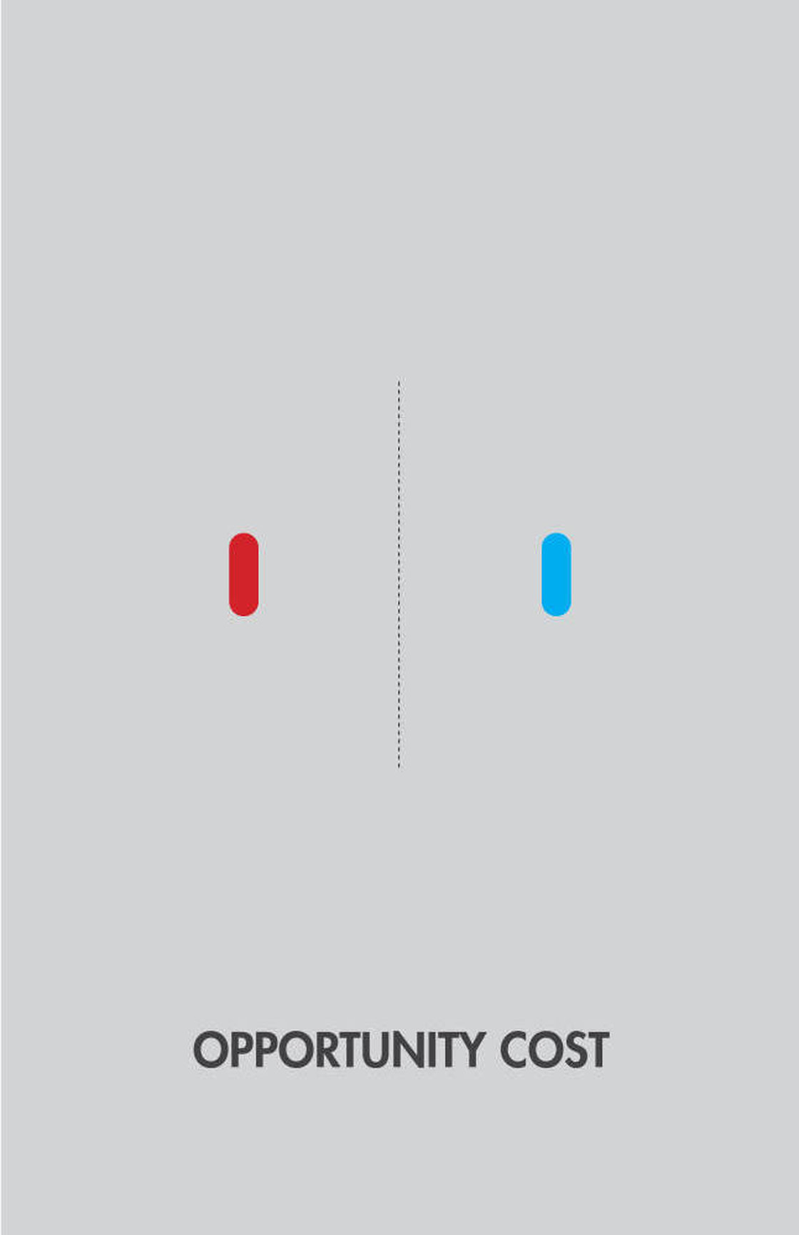
Opportunity Cost
Economists know that resources have many different uses.
When we make an economic choice, we always give up an alternative.

Slide 7
Opportunity Cost
Opportunity cost = the value of the next best alternative that must be given up to obtain something.
Scarcity
Choices/Opportunity Cost

Slide 8
Complete the front and back of first page of the practice sheet

Slide 9
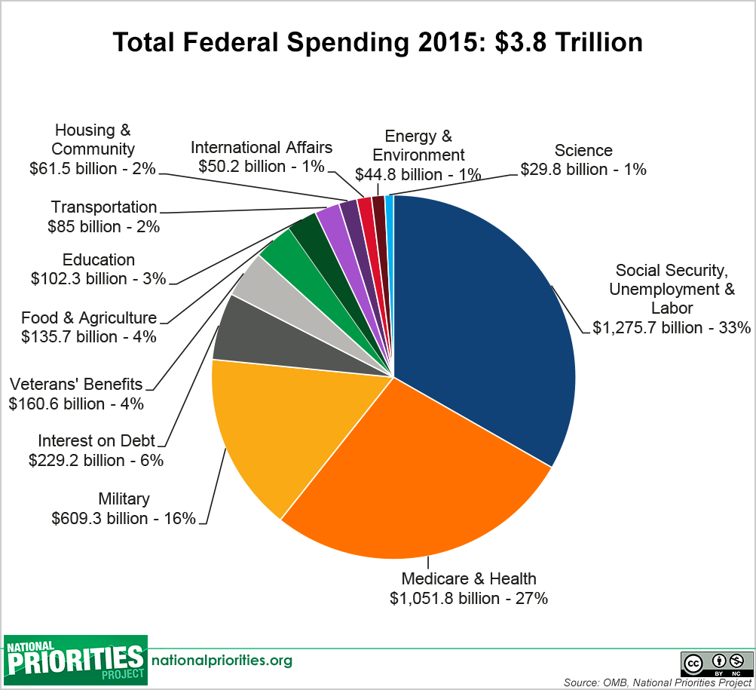

Slide 10
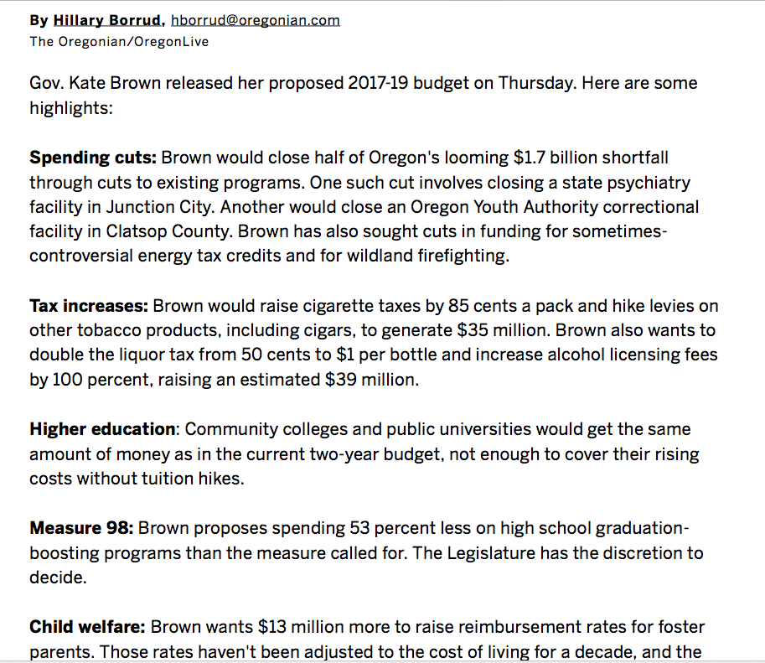

Slide 11
What’s the Point?
Scarcity
Choices/Opportunity Cost
Economics studies how these choices are made and is a tool for helping people decide if society is making the right choices

Slide 12
Production Possibilities Curve (PPC)

Slide 13
Production Possibilities Curve (PPC)
Represents all combinations of the maximum amounts of two goods that can be produced by an economy
All the points on the curve are known as production possibilities

Slide 14
Production Possibilities
Point | Microwaves | Computers
A | 40 | 0
B | 35 | 17
C | 26 | 25
D | 15 | 31
E | 0 | 33

Slide 15
Choice
BASIC ECONOMIC QUESTIONS
What to produce?
How to produce it?
Who to produce it for?
Scarcity
Choices

Slide 16
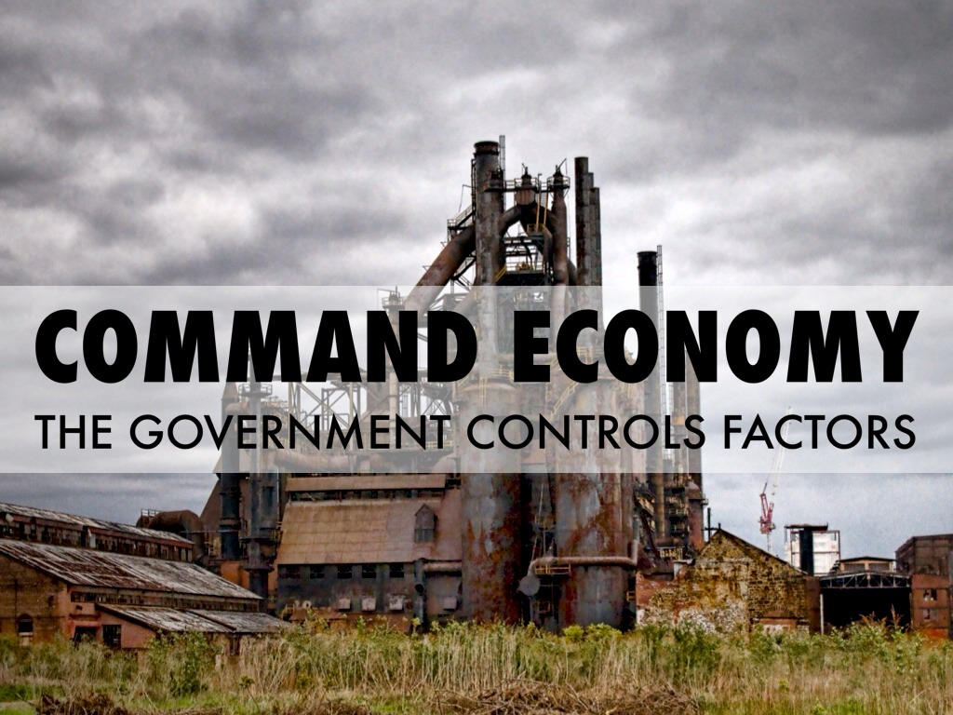
Command Economy
An economy in which production is determined centrally by a government.

Slide 17
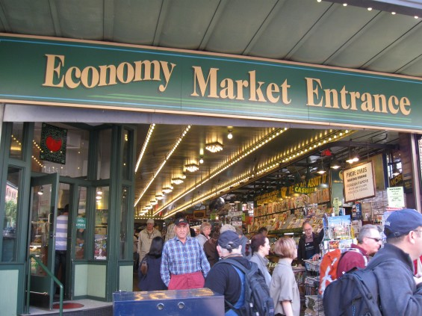
Free Market Economy
An economy in which the allocation of resources is free from government intervention

