Slide 1
Economic Integration

Slide 2
Economic Integration
Economic Integration – economic cooperation between countries and coordination of their economic policies

Slide 3
Kinds of Economic Integration
Preferential Trade Agreements
Trading Blocs
Monetary Unions

Slide 4
Preferential Trade Agreements
An agreement between two or more countries to lower trade barriers between each other, on certain products.
Bilateral Trade Agreements – Between two countries
Multi-lateral Trade Agreements – Agreement between many countries

Slide 5
Bilateral Trade Agreement
Thailand
Australia
Agricultural Products

Slide 6
Multilateral Trade Agreement
Thailand
Australia
India
Russia

Slide 7
Trading Blocs
A group of countries that have agreed to reduce trade barriers to encourage free trade.
Free Trade Area
Customs Union
Common Market
More Integration

Slide 8
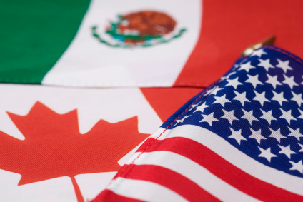
1. Free Trade Area
Group of countries that agree to slowly eliminate trade barriers
Each country still has its own trade policies towards non-member countries
There may be free trade in some products and protection in others
Examples: NAFTA, ASEAN, SAARC

Slide 9
Free Trade Area
Thailand
United States
Laos
Vietnam

Slide 10
2. Customs Union
Group of countries that do the same things as a free trade area BUT ALSO have common policies towards non-member countries.
Countries are not free to decide their own trade policies
Examples: CEFTA, SACU, PARTA

Slide 11
Customs Union
Thailand
United States
Laos
Vietnam

Slide 12
3. Common Market
Group of countries that do the same things as a customs union BUT ALSO eliminate all restrictions on the movement of factors of production (labor, capital)
Examples: EEC

Slide 13
Common Market
Thailand
United States
Laos
Vietnam

Slide 14
Advantages of Trading Blocs
Increased competition
Larger Markets
Lower Prices
Increased Investment

Slide 15
Advantages of Trading Blocs
Better use of Resources
Economic Growth
Friendship

Slide 16
Disadvantages of Trading Blocs
Trading blocs may create obstacles to global free trade
Unequal distribution of gains and losses within a trading bloc

Slide 17
Trade Blocs
ASEAN
UNASUR
ECOWAS
APTA
NAFTA
SAARC
SACU

Slide 18
Monetary Union
Monetary Union – when member countries use the same currency and share a central bank

Slide 19
Advantages
No more exchange rate changes
No more exchange costs
Greater investment from foreign countries

Slide 20
Disadvantages
Individual countries can no longer control their own exchange rate
Individual countries lose their central bank and control of monetary policy
Less control of fiscal policy (government spending)

