Slide 1
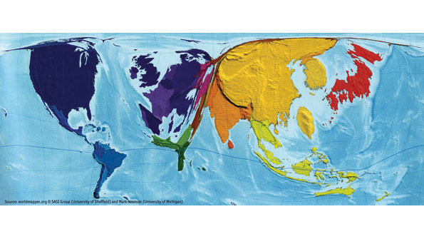

Slide 2
Foreign Debt

Slide 3
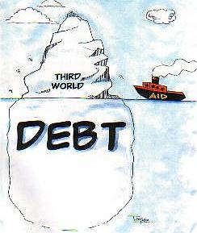
Foreign Debt

Slide 4
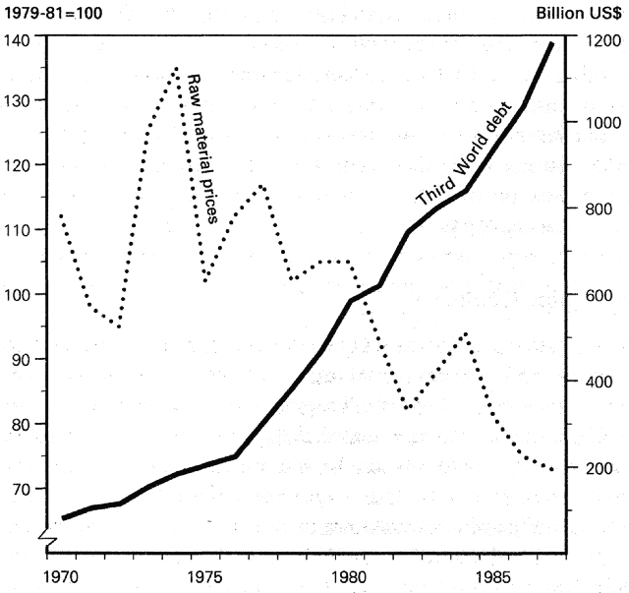
Third World Debt

Slide 5
International Monetary Fund (IMF)
Created along with World Bank and GATT (later WTO) in 1947
Important in trying to solve “Third World Debt Crisis”

Slide 6
Structural Adjustment Policies
Trade liberalization
Commodity exports encouraged
Devaluing of currency
FDI encouraged
Privatization of national industries
Reduced government expenditure
Charging for basic services (education, health care)
Removal of subsidies and price controls
Reduced corruption

Slide 7
Structural Adjustment Policies
Brought some positive effects, but potentially at the cost of the poor (de-development):
Increased unemployment
Lack of basic services for those who could not pay
Fall in real wages
Increased prices of necessities

Slide 8
Foreign Debt
In 1997, Zambia spent 40% of its total budget to repay foreign debt, and only 7% for basic services
Nigeria borrowed $17 billion dollars, has paid $18 billion back, and still owes $34 billion

Slide 9
Debt Forgiveness
Pressure to offer debt relief
2010 – debt owed by developing countries was over $4tn

