Slide 1
Poverty trap/Poverty cyle

Slide 2
Poverty Cycle/Poverty Trap
There are many things that cause poverty in a country
Sometimes poverty can cause more poverty. We call this the poverty cycle.

Slide 3
Poverty Cycle

Slide 4
Measures of Development
Top 10 list

Slide 5
Financial Measures

Slide 6
Financial Measures
GDP (per capita)
GNI (per capita)

Slide 7
GDP
Thailand
$345,672,232,116
29th
United Arab Emirates
$360,245,074,960
28th
Denmark
$333,616,014,898
30th

Slide 8
GDP Per Capita
Thailand
$4,972
91st
United Arab Emirates
$45,663
19th
Denmark
$59,852
8th

Slide 9
Financial Measures
GDP vs. GNI

Slide 10
Country | GDP per capita (current US$) 2008 | GNI per capita (current US$) 2008 | GNI-GDP (% of GDP)
USA | 46350
UK | 43541
France | 44508
Botswana | 6982
Cameroon | 1226
India | 1017
Indonesia | 2246
Vietnam | 1051

Slide 11
Country | GDP per capita (current US$) 2008 | GNI per capita (current US$) 2008 | GNI-GDP (% of GDP)
USA | 46350 | 47930
UK | 43541 | 46040
France | 44508 | 42000
Botswana | 6982 | 6640
Cameroon | 1226 | 1150
India | 1017 | 1040
Indonesia | 2246 | 1880
Vietnam | 1051 | 890

Slide 12
Country | GDP per capita (current US$) 2008 | GNI per capita (current US$) 2008 | GNI-GDP (% of GDP)
USA | 46350 | 47930 | 3.4
UK | 43541 | 46040 | 5.7
France | 44508 | 42000 | -5.6
Botswana | 6982 | 6640 | -4.9
Cameroon | 1226 | 1150 | -6.2
India | 1017 | 1040 | 2.3
Indonesia | 2246 | 1880 | -16.3
Vietnam | 1051 | 890 | -15.3

Slide 13
Purchasing Power of Parity (PPP)

Slide 14
GDP per capita and GNI per capita (2009)
Country | GNI per Capita ($) | GDP per Capita ($)
Japan | 37670 | 34313
Switzerland | 59880 | 56207
United States | 46040 | 45592
Colombia | 3250 | 4724
China | 2360 | 2432
India | 950 | 1046

Slide 15
GDP per capita and GNI per capita (2009)
Looking at GDP per Capita across countries is misleading
Each country has different prices and different purchasing power
What we need to do is change these numbers to take this difference into account

Slide 16
Purchasing Power of Parity (PPP)
Purchasing Power of Parity (PPP) – gets rid of the differences in prices across countries
Country | GDP per Capita ($) | GDP per Capita PPP ($)
Japan | 34313 | 33632
Switzerland | 56207 | 40658
United States | 45592 | 45592
Colombia | 4724 | 7764
China | 2432 | 5383
India | 1046 | 2753

Slide 17
Health Measures

Slide 18
Health Measures
Life expectancy at birth
Infant mortality rate

Slide 19
Education Measures

Slide 20
Education Measures
Adult literacy
Enrolment in primary education

Slide 21
Human Development Index (HDI)

Slide 22
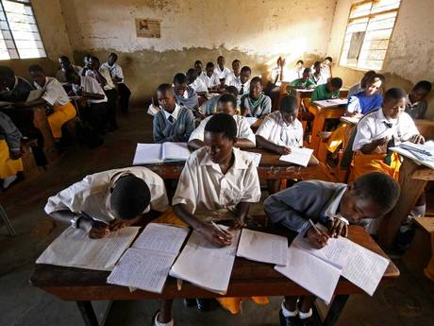
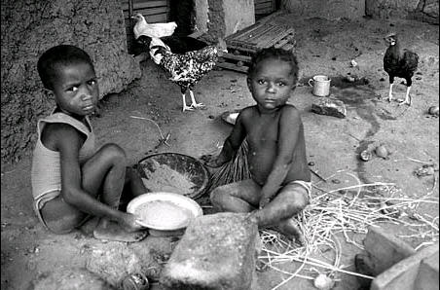
Composite indicators
To measure development (quality of life), many things are put together
When many things are put together into one measurement, we call this a composite indicator

Slide 23
Human Development Index (HDI)
Best-known and most widely used measurement of economic development
Measures three things:
Life expectancy (years expected at birth)
Schooling (mean and expected years or schooling)
Standard of living (GNI per capita PPP US$)
Each of these is given a value between 0 and 1 and then averaged.

Slide 24
Human Development Index (HDI)
Category | HDI Values | Number of countries | % of World’s Poplation
Very high human development | HDI > 0.9 | 49 | 30%
High human development | 0.9 > HDI > 0.8 | 53
Medium human development | 0.8 > HDI > 0.5 | 42 | 51%
Low human development | 0.5 > HDI | 43 | 19%

Slide 25
Practice
Sri Lanka has a higher HDI than Thailand even though Thailand has a much higher GNI per capita (PPP). Why is this?

