Slide 1
The Empowerment of Women

Slide 2
Problems of Gender Inequality
Health – more deaths among girls than boys in developing countries
Education – girls don’t always have the same opportunities as boys
Work – less jobs and lower pay for women
Inheritance and property rights
Access to credit

Slide 3
Empowerment of Women
Empowerment of Women – getting rid of gender inequality; giving women the same rights and opportunities as men.

Slide 4
Benefits of Women’s Empowerment
Lower child mortality rates
Better educational achievements of children
Better Human Capital
Lower Birth Rates

Slide 5
Income Distribution

Slide 6
Income Distribution
High income inequality is a barrier to growth and development

Slide 7
Problems with unequal distributions
High income inequality means…
lower savings
poor people can’t get credit because they have to collateral
a decrease demand of local goods and services
political control by a small group
less political stability

Slide 8
The Lorenz Curve and the Gini coefficient

Slide 9
Income Distribution
Country | Poorest 20% | Second 20% | Third 20% | Fourth 20% | Richest 20% | Gini coefficient
Belarus (2007) | 8.8 | 13.4 | 17.5 | 22.6 | 37.7 | 0.28
Bolivia (2008) | 2.7 | 6.5 | 11.0 | 18.6 | 61.2 | 0.58

Slide 10
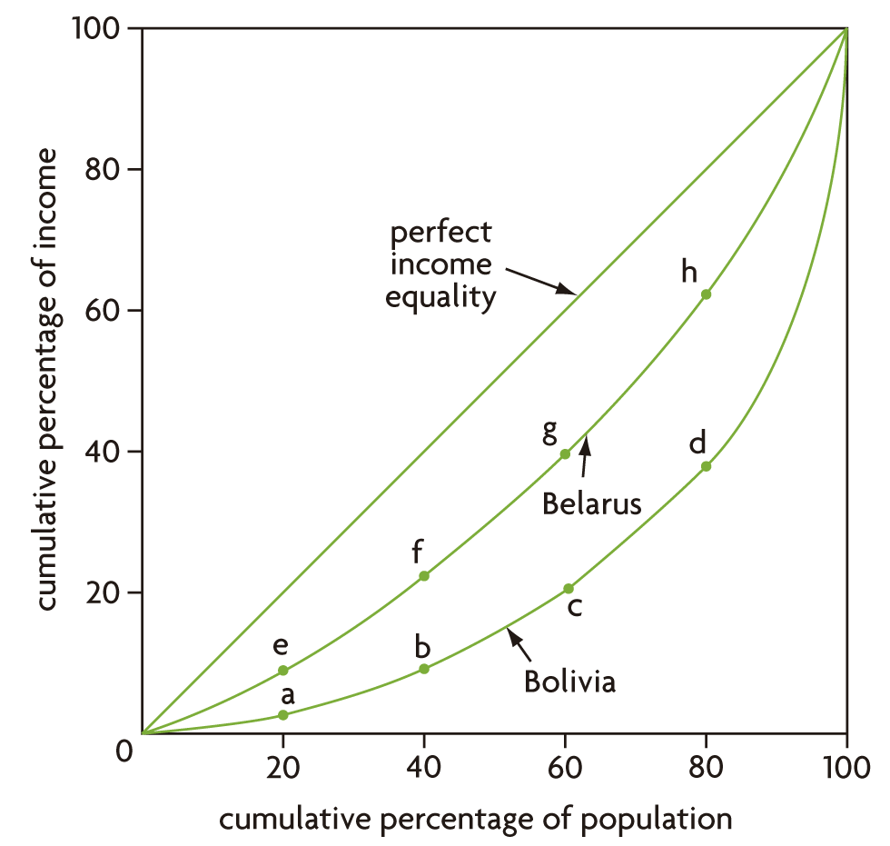
Income Distribution

Slide 11
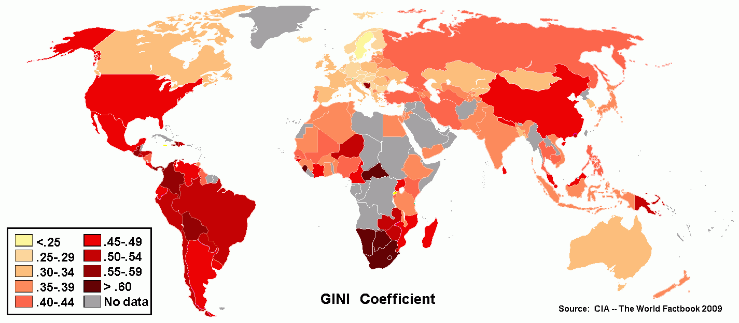
GINI coefficients

