Slide 1
How do you develop a country?

Slide 2
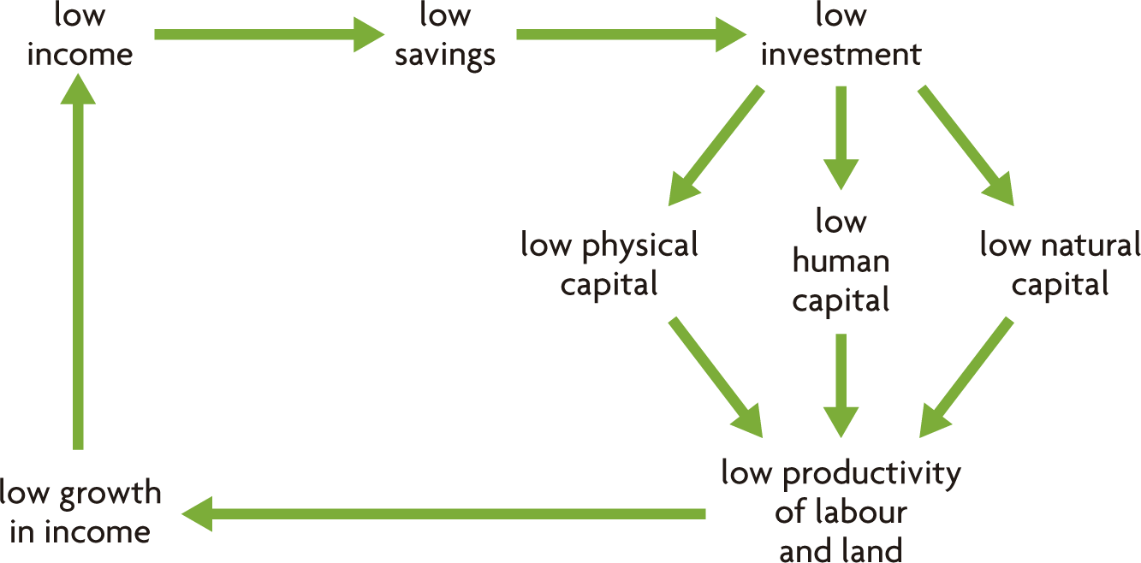
Poverty Cycle

Slide 3
Education and Health as a Development Strategy

Slide 4
Educational and Health: The Development of Human Capital
Human Capital – The skills, abilities and knowledge of people. These things make people productive.
Improving education and health are the two most important ways to improve human capital.

Slide 5
Educational and Health: The Development of Human Capital
Many people believe education and health are fundamental rights of people everywhere.
Education and health are merit goods. This means that they have positive externalities and, if left to the market, they are underprovided (we don’t get enough).

Slide 6
Positive Externality
When there are hidden benefits from the production or consumption of a good or service.
Because some of the benefits are hidden, the market will not supply or demand enough of these goods.

Slide 7
Positive Externalities of Education
Better education increases productivity
Better education increases physical capital as people develop new technologies
Better education attracts foreign investment and lowers unemployment
Better education increases political stability
Better education decreases the crime rate
Better education for women lowers the birth rate and leads to healthier mothers and children

Slide 8
Positive Externalities of Health
Better health increases productivity
Better health increases people’s participation in their community
Better health increases school attendance and performance

Slide 9
Government policies in Health and Education
There are good reasons for government involvement
Subsidies
Direct Government Provision
Legislation
Advertising

Slide 10
Investing in Education
East Asia’s progress
Primary education vs. Secondary education
Brain Drain
International Brain Drain
Internal Brain Drain

Slide 11
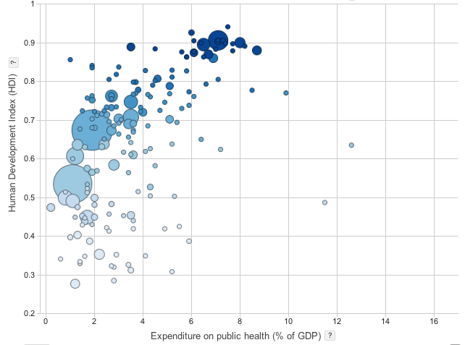
Investing in Health
25 Feb 2013 | archived in: HDI, public spending and public health

Slide 12
