Slide 1
Capital Goods

Slide 2
Technological Development Strategy

Slide 3
Poverty Cycle

Slide 4
Technology: The Development of Physical Capital
Physical Capital/Capital Goods – machines, tools, equipment

Slide 5
Appropriate Technology
Appropriate Technology – technology that is good for the country’s economic and geographical conditions.

Slide 6
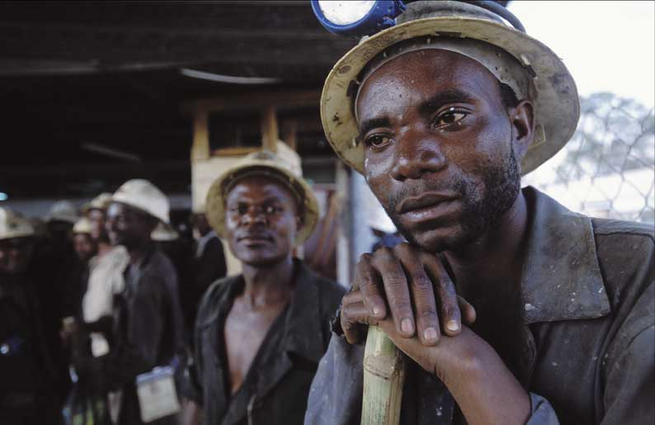
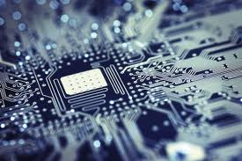
Appropriate Technology
Developing Countries
Developed Countries
Large quantities of labor
Less ability to produce, maintain and operate complex technology
Lower quantities of labor
More ability to produce, maintain and operate complex technology

Slide 7
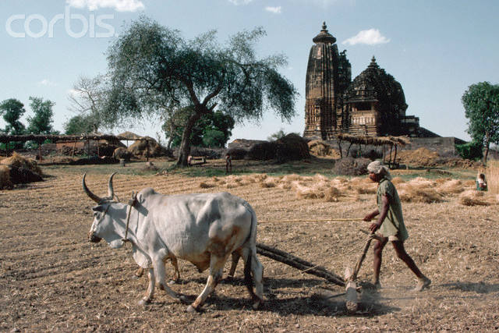
Appropriate Technology
Developing and developed countries need different technologies
Example: Farming equipment

Slide 8
Appropriate Technology
Labor-using Technology
Capital-using Technology
More labor/less capital
Increase local employment
Use local skills and materials
Doesn’t require importation
Less labor/more capital
Increase local unemployment
Require skills that are hard to acquire
Often must be imported

Slide 9
Appropriate Technology
Problems with developing and using appropriate technology
Most new technologies are capital-using. Why?
Most new technologies come from developed countries.
Developed countries spend more than 2% of GDP of R&D. Developing countries spend less than 0.5%.
There is a lack of incentives to create new technologies in developing countries. No market for technologies.
Example: medicine

Slide 10
Infrastructure

Slide 11
Poverty Cycle

Slide 12
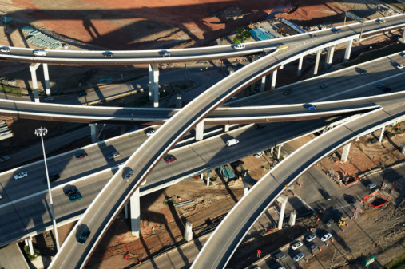
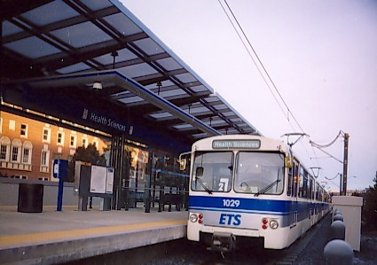
Infrastructure
Infrastructure – power lines, pipes, roads, dams, canals, ports, airports, etc.
Infrastructure is a type of physical capital

Slide 13
Infrastructure
Development of infrastructure is largely a government responsibility. Why?
Extremely important
Public goods (Non-exclusivity)
Monopoly

Slide 14
Infrastructure
Infrastructure is very important to economic development
Increase productivity
Lower costs of production
Increases foreign investment
Increase health and education by connecting people with schools and hospitals
Increased gender equality

Slide 15
Problems with Infrastructure in Developing Countries
Problems financing
Inadequate maintenance and poor quality
Limited access by the poor
Misallocation of resources
Neglect of the Environment

