Slide 1
Foreign Direct Investment (FDI)

Slide 2
Foreign Direct Investment (FDI)
Foreign Direct Investment (FDI) – investment by firms based in one country in productive activities in another country
Multinational Corporation (MNC) – firm that undertakes foreign direct investment
These companies work in more than one country

Slide 3
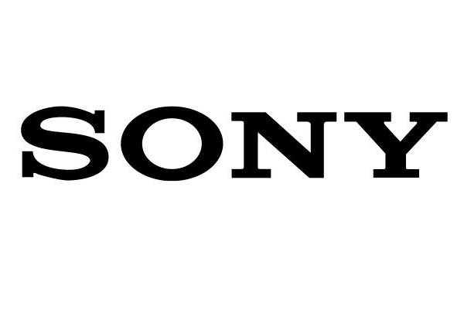
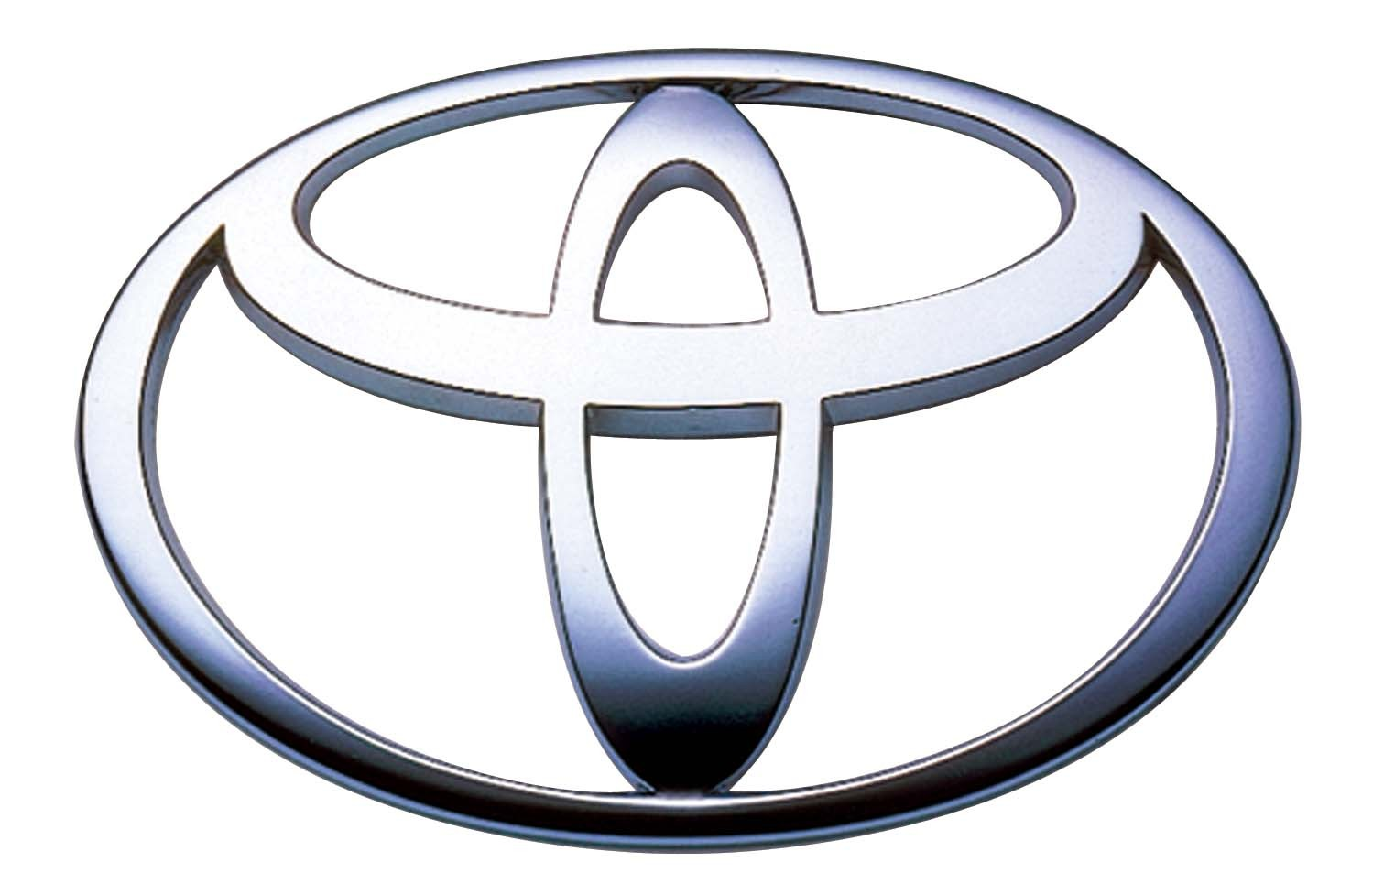

Slide 4
Foreign Direct Investment (FDI)
MNCs are HUGE
In 2008, the ten biggest MNCs had sales valued at about three times the total GDP of all the countries in Sub-Saharan Africa combined.
Their total assets were about the size of the GDP of China and about two and half times the GDP of India

Slide 5
Foreign Direct Investment (FDI)
MNCs have grown very quickly since the 1950’s.
In the early 1990’s – 37,000 MNCs
2009 – 82,000 MNCs which employed 80 million people in foreign sections alone
Foreign sections of MNCs account for 11% of the world’s GDP
At first, most FDI went from one developed country to another
Today, there is increasing FDI in developing countries
There are also increasing numbers of MNC headquartered in developing countries

Slide 6
Why MNCs expand into developing countries
Profit
Increase sales and revenues
Bypass trade barriers
Lower costs of production
Use locally produced raw materials
Further their activities in natural resource extraction

Slide 7
Developing country characteristics that attract MNCs
What makes a MNC want to invest in one developing country instead of another?

Slide 8
 | Round 1 |  | Round 2 |  | Round 3 |  | Round 4 |  | Round 5
 | Friendly to capital points | Game points | Friendly to capital points | Game points | Friendly to capital points | Game points | Friendly to capital points | Game points | Friendly to capital points | Game points
Country 1
Country 2
Country 3
Country 4
Country 5
Country 6
Country 7

Slide 9
Foreign Direct Investment (FDI) - 2009
Host Region | % of World | % of Developing Countries
World | 100
Developed Countries | 54.2
Developing Countries | 45.8 | 100
Latin America and Caribbean | 11.2 | 24.4
North Africa and Middle East | 8.3 | 18.1
Sub-Saharan Africa | 3.9 | 8.4
East Africa | 14.8 | 32.4
(of which, China) | (9.1) | (19.9)
South and South East Asia and Oceania | 7.7 | 16.7

Slide 10
Developing country characteristics that attract MNCs
Political stability
Stable macroeconomic environment
low inflation, stable currency, low debt
Laws that favor FDI
Low cost of factor inputs
Freedom to send profits home
No exchange controls (easy imports)
Low taxes
Laws allowing foreign ownership
Strong property rights
Laws that minimize risk of nationalization

Slide 11
Developing country characteristics that attract MNCs
Liberal trade policies (no tariffs, quotas, etc.)
Large markets (lots of buyers)
Rapid economic growth
Good infrastructure
Good education

Slide 12
 | Round 1 |  | Round 2 |  | Round 3 |  | Round 4 |  | Round 5
 | Friendly to capital points | Game points | Friendly to capital points | Game points | Friendly to capital points | Game points | Friendly to capital points | Game points | Friendly to capital points | Game points
Shunya | 345 | 25 | 265 |  | 335 | 25 | 328 |  | 326
USSR | 319 | 50 | 319 | 100 | 322 |  | 330 |  | 344 | 25
Grassland | 279 |  | 339 | 25 | 308 |  | 331 | 100 | 342 | 50
Fluff land | 230 |  | 315 |  | 320 |  | 333 | 25 | 330
DRFP | 307 | 100 | 306 |  | 324 | 100 | 330 |  | 336 | 100
Holy Roman Empire | 236 |  | 326 | 50 | 332 | 50 | 332 | 50 | 335

