Slide 1
20 minutes
Using at least one production possibility curve diagram, explain the concepts of scarcity, choice, opportunity cost and resource allocation.

Slide 2
Choice
BASIC ECONOMIC QUESTIONS
What to produce?
How to produce it?
Who to produce it for?
Scarcity
Choices

Slide 3
Command Economy
An economy in which production is determined centrally by a government.

Slide 4
Free Market Economy
An economy in which the allocation of resources is free from government intervention

Slide 5
Markets and Demand

Slide 6
What is a market?

Slide 7
Market
Market – any situation where buyers and sellers of goods, services or resources are linked together to carry out an exchange

Slide 8
Demand

Slide 9
Demand
Demand shows the quantities of a good or service consumers are willing and able to buy at different possible prices

Slide 10
Individual Demand
Price of chocolate bars ($) | Quantity of chocolate bars demanded (per week)
5 | 2
4 | 4
3 | 6
2 | 8
1 | 10

Slide 12
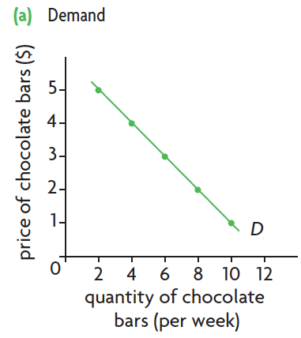

Slide 13
Law of Demand
As the price of a good increases, the quantity demanded falls
As the price of the good falls, the quantity demanded increases
Ceteris Paribus
Price
Quantity Demanded
Price
Quantity Demanded

Slide 14
Individual Demand to Market Demand
Market demand shows the total quantities of goods consumers in the market are willing and able to buy at different prices.
Market demand is the sum of all individual demands for a good.

Slide 15
Individual Demand to Market Demand

Slide 16
Non-price determinants of Demand

Slide 17
Law of Demand
As the price of a good increases, the quantity demanded falls
As the price of the good falls, the quantity demanded increases
Price
Quantity Demanded
Price
Quantity Demanded

Slide 18
Change in Quantity Demanded

Slide 19
Non-price determinants of demand
Non-price determinants of demand are things other than price that can influence demand.
Population
Income
Related Goods
Advertising
Tastes
Expectations
Seasons

Slide 20
Non-price determinants of demand

Slide 21
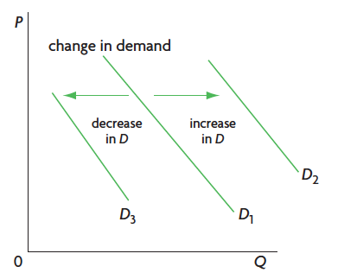
Non-price determinants of demand
Changes in the determinants of demand cause shifts in the demand curve: the entire curve moves left or right.

Slide 22
Non-price determinants of demand
A rightward shift in the demand curve indicates that more is demanded at any given price. This is called an increase in demand.

Slide 23
Non-price determinants of demand
A leftward shift in the demand curve indicates that less is demanded at any given price. This is called an decrease in demand.

Slide 24
Non-price determinants of demand
Non-price determinants of demand are things other than price that can influence demand.
Population
Income
Related Goods
Advertising
Tastes
Expectations
Seasons

Slide 25
Income
An increase in income leads to a rightwards shift (increase) in demand for normal goods. Most goods are normal goods.
An increase in income leads to a leftward shift (decrease) in demand for inferior goods.
Income
Demand
Income
Demand

Slide 26
Prices of Related Goods
Substitutes
If the price of a substitute good (X) decreases, demand for a good (Y) decreases.
If the price of a substitute good (X) increases, demand for a good (Y) increases.
Example: Coke and Pepsi
Price of Substitute
Demand
Price of Substitute
Demand

Slide 27
Prices of Related Goods
Complements
If the price of a complement good (X) decreases, demand for a good (Y) increases.
If the price of a complement good (X) increases, demand for a good (Y) decreases.
Example: DVDs and DVD players
Price of complement
Demand
Price of complement
Demand

Slide 28
Lesson Objectives
Distinguish between movements along the demand curve and shifts of the demand curve.
Draw diagrams to show the difference between movements along the demand curve and shifts of the demand curve.
Explain how factors including changes in income (in the cases of normal and inferior goods), preferences, prices of related goods (in the cases of substitutes and complements) and demographic changes may change demand.

Slide 29
20 minutes
With the aid of at least one diagram, explain the difference between a movement along an existing demand curve for a good and a shift of the demand curve for a good.

