Slide 1
Paper 1 Practice - Demand
20 minutes:
With the aid of at least one diagram, explain the difference between a movement along an existing demand curve for a good and a shift of the demand curve for a good.
Definitions/Diagrams/Examples

Slide 2
Supply

Slide 3
Supply
How much of a product are sellers willing to make?
Supply tells us the quantity of a product firms are willing and able to produce at different prices.

Slide 4
Supply
What is the goal of firms?
To get the largest profit possible

Slide 5
Supply
Price of Chocolate Bars ($) | Quantity of chocolate bars supplied (per week)
5 | 600
4 | 500
3 | 400
2 | 300
1 | 200

Slide 6
Supply

Slide 7
Law of Supply
As the price of a good increases, the quantity supplied increases
As the price of the good falls, the quantity supplied falls
Price
Quantity Supplied
Price
Quantity Supplied

Slide 8
Change in Quantity Supplied

Slide 9
Why does the supply curve slope upward?
Higher prices mean higher profits so firms have a reason to make more of a product.
Lower prices mean lower profits so firms have a reason to make less of a product.

Slide 10
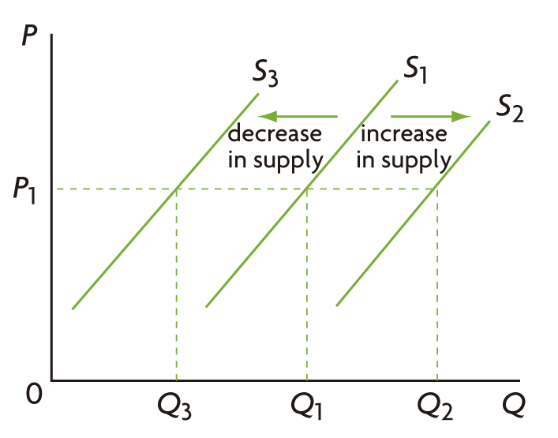
Non-price determinants of Supply
Things other than price that can influence supply:
Costs of factors of production
Technology
Prices of related good
Taxes
Subsidies
Number of Firms
Shocks

Slide 11
Costs of factors of production
Costs of Factors of Production
Supply
Costs of Factors of Production
Supply

Slide 12
Technology
Technology
Supply

Slide 13
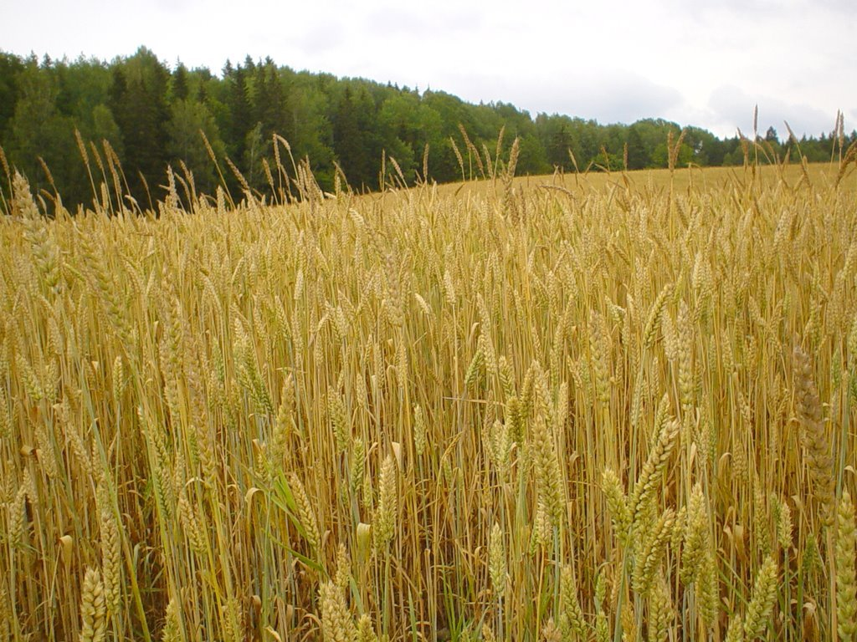
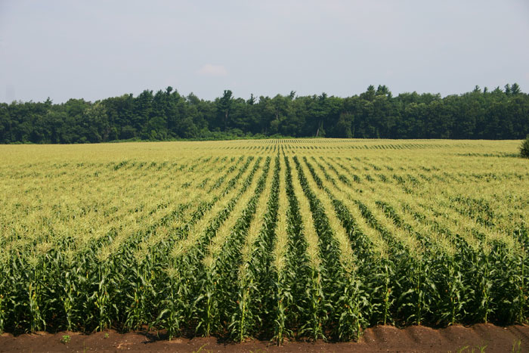
Prices of Related Goods: Competitive Supply
Competitive Supply – Some goods need the same resources in order to be produced. This means that producing one good means producing less of the other.
Example: Corn/Wheat

Slide 14
Prices of Related Goods: Competitive Supply
OR

Slide 15
Prices of Related Goods: Competitive Supply
Price of related good
Supply
Price of related good
Supply

Slide 16
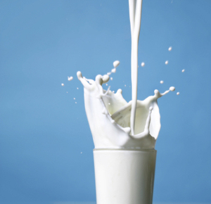
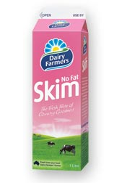
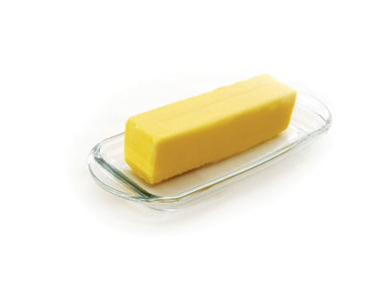
Prices of Related Goods: Joint Supply
Joint Supply – Some goods are always made together at the same time. This means that producing more of one good means producing more of the other too.
Example: Whole milk – skim milk and butter
AND

Slide 17
Prices of Related Goods: Joint Supply
Price of related good
Supply
Price of related good
Supply

Slide 18
Prices of Related Goods: Taxes
Taxes
Supply
Taxes
Supply

Slide 19
Subsidies
A subsidy is a payment made by the government to a firm in exchange for making a product.
Governments use subsidies to increase the incomes of producers or encourage the increase in the production of a good.

Slide 20
Subsidies
Subsidies
Supply
Subsidies
Supply

Slide 21
Number of Firms
Number of Firms
Supply
Number of Firms
Supply

Slide 22
Shocks
Shocks are sudden, unpredictable events
Examples: Bad weather that destroys crops, war, natural or man-made disasters.
These almost always cause a decrease in supply
SHOCK
Supply

Slide 23
Draw the below changes in supply
The number of firms in the industry producing product A decreases.
The price of oil, a key input in the production of product A, increases.
The government gives a subsidy on each unit of A produced.
The price of product B falls, and B is in competitive supply with A. (Draw two graphs)
The price of product B increases, and B is in joint supply with A. (Draw two graphs)
A new technology is adopted by firms in the industry producing A.

